Slide 1



Rohan Project
View in Power BI
Last data refresh:
24/08/2022 16:41:23 UTC
Downloaded at:
24/08/2022 16:42:17 UTC

Slide 2
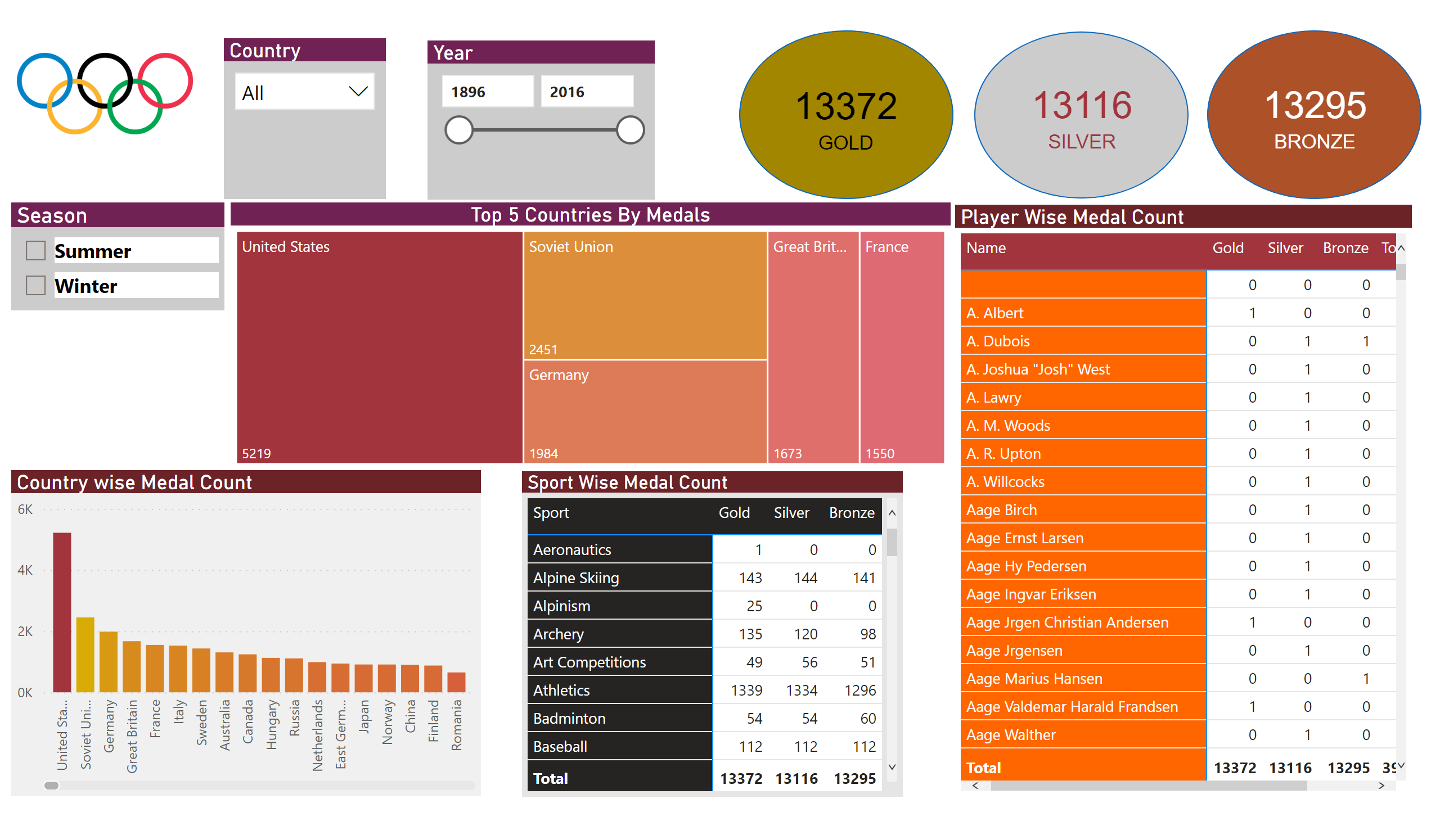
Page 1
Notes:
image
No alt text provided
Country
No alt text provided
Season
No alt text provided
Year
No alt text provided
shape
No alt text provided
shape
No alt text provided
shape
No alt text provided
card
No alt text provided
card
No alt text provided
card
No alt text provided
Top 5 Countries By Medals
No alt text provided
Country wise Medal Count
No alt text provided
Sport Wise Medal Count
No alt text provided
Player Wise Medal Count
No alt text provided

